Slide 1
PRESENTATION ON CYBER SECURITY
PRESENTED BY:
PUSPARAJ MAINALI
SARHANA SUWAL
ROHAN KOIRALA
ROHAN MAHARJAN
SAROJ BASNET
GROUP -F

Slide 2
DISCUSSED TOPICS
1.CYBER SECURITY
–PUSPARAJ MAINALI
2.CYBER CRIME
–SARAHANA SUWAL
3.CYBER ATTACK EFFECTS
– ROHAN MAHARJAN
4.MEASURE TO PREVENT CYBER CRIME USING CYBER SECURITY
– ROHAN KOIRALA
5. CONCLUSION
– SAROJ BASNET

Slide 3


WHAT IS CYBER SECURITY?
- Cyber security is the practice of protecting systems, networks, and programs from digital attacks. These cyber attacks are usually aimed at accessing, changing, or destroying sensitive information; extorting money from users; or interrupting normal business processes.

Slide 4
CYBER SECURITY
Points
The measures to be taken to avoid the entrance of unauthorized individual from accessing the crucial information is cyber security.
01
To prevent or protects file from unwanted access, modification and deletion of files without authorization.
02
It is necessary as the digital information stored in computer shares important personal details of individual company offices and different systems.
03

Slide 5
CYBER CRIME
01
Any offensive activities that leads harm to individual or group by the use of internet can be known as cyber crime.
02
Computers are used and sometimes computers are made target by hackers to get the data and information illegally.
03
Cyber crime is considered as high profile crime and culprit can be penalized or kept in prison according to the law.
04
With the advancement in networking and technology cyber crimes are also increasing.

Slide 6
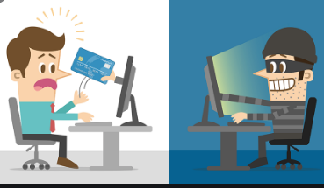
Identity theft

Slide 7
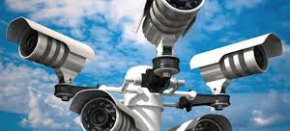
Unwanted mass surveillance

Slide 8

Copyright infringement

Slide 9
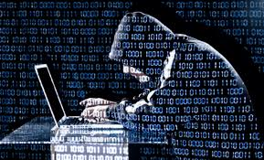
Hacking

Slide 10
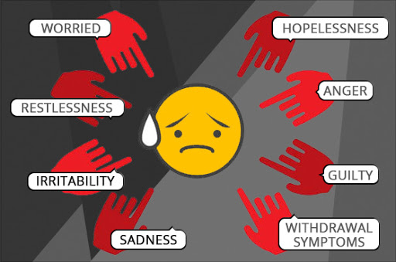
Effects of cyber attacks
Mental suffering
loss of important data and information
Loss of time
Bank corruption
Online harassment
Drug trafficking

Slide 11
MEASURE TO PREVENT USING CYBER SECURITY
1.Firstly, make internet connection secure.
2.While using social media platforms , we need to be concerned about privacy settings.
3.Encryption can be key to secure data.
4.The password should be strong enough and should not be shared with others
5.For preventing virus attacks antivirus program should be updated.
6.We should create backups.
7.Everyone who needs cyber security should be educated and aware about cyber crimes.

Slide 12
Conclusion
Everything that exist in the world has negative and positive aspects. It depends on the user how to minimize the negativity and increase the productivity. Likewise, the use of computer and internet can be boon or bane depending on its use.

Slide 13
Thank you!!!
o

